Slide 1
Topic: Place Value
EQ: How do we use patterns of tens in a numbers chart?
Get your VIVO’s
Topic and EQ in Interactive Notebook
Complete on working out side:
1. What number is halfway between -1 and -13
2. What number is halfway between 7 and -19
Notes:
-1+-13= -14/2=-7
7+-19= -12/2=-6

Slide 2
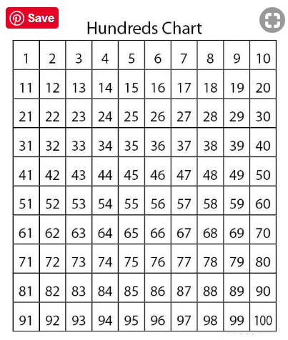
24
7
30
Date
Integers
EQ: How do we use patterns of tens in a numbers chart?
Our number system is “base ten” which means that we work in multiples of ten
5

Slide 3
Vocabulary
Place Value – The value a digit has because of its position in a number
Digit – Any of the numerals from 0 to 9 used to form numbers
Partition – Divide into parts
Place holder – A significant zero in the place value of a number

Slide 4
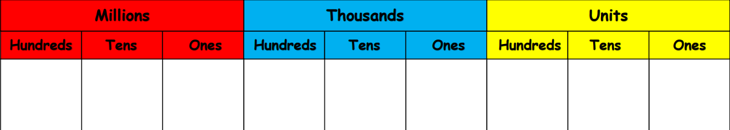

Slide 5
What number is represented below? Write it in figures and words
What mistake are people most likely to make? Why?
  Use a place value grid to support you and remember place holders

Slide 6
What number is represented below? Write it in figures and words
Why is the zero in a number important when representing larger numbers?
  Use a place value grid to support you and remember place holders

Slide 7
What number is represented below? Write it in figures and words
How else could the same number be represented?
  Use a place value grid to support you and remember place holders

Slide 8
523,602 = 500,000 + 20,000 + 3,000 + 600 + 2

Slide 9
341,000 = _________ + 40,000 + _________
Why is it important to be able to partition numbers?
  Use a place value grid to support you and remember place holders

Slide 10
203,201 = _________ + _________ + _________ + _________
+ _________
Why don’t we include the ‘empty’ place values?
  Use a place value grid to support you and remember place holders

Slide 11
Identify the value of 9 in each of the numbers below:
679,372
984,748
867,892
297,453
676,329
How is the same digit worth different values?
  Use a place value grid to support you and remember place holders

Slide 12
Activity

